Slide 1
THE LIFE OF CHRIST
PART 64

Slide 2
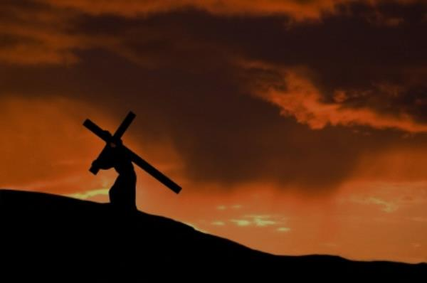
Luke 14:25 Now great multitudes went with Him. And He turned and said to them, ²⁶ "If anyone comes to Me and does not hate his father and mother, wife and children, brothers and sisters, yes, and his own life also, he cannot be My disciple. ²⁷ "And whoever does not bear his cross and come after Me cannot be My disciple.

Slide 3
Matthew 10:37 "He who loves father or mother more than Me is not worthy of Me. And he who loves son or daughter more than Me is not worthy of Me.

Slide 4
Luke 14:28 "For which of you, intending to build a tower, does not sit down first and count the cost, whether he has enough to finish it -- ²⁹ "lest, after he has laid the foundation, and is not able to finish, all who see it begin to mock him, ³⁰ "saying, 'This man began to build and was not able to finish.' ³¹ "Or what king, going to make war against another king, does not sit down first and consider whether he is able with ten thousand to meet him who comes against him with twenty thousand? ³² "Or else, while the other is still a great way off, he sends a delegation and asks conditions of peace. ³³ "So likewise, whoever of you does not forsake all that he has cannot be My disciple.

Slide 5
Luke 14:34 " Salt is good; but if the salt has lost its flavor, how shall it be seasoned? ³⁵ "It is neither fit for the land nor for the dunghill, but men throw it out. He who has ears to hear, let him hear!"

Slide 6
Luke 15:1 Then all the tax collectors and the sinners drew near to Him to hear Him. ² And the Pharisees and scribes complained, saying, "This Man receives sinners and eats with them." ³ So He spoke this parable to them, saying: ⁴ "What man of you, having a hundred sheep, if he loses one of them, does not leave the ninety-nine in the wilderness, and go after the one which is lost until he finds it? ⁵ "And when he has found it, he lays it on his shoulders, rejoicing. ⁶ "And when he comes home, he calls together his friends and neighbors, saying to them, 'Rejoice with me, for I have found my sheep which was lost!' ⁷ "I say to you that likewise there will be more joy in heaven over one sinner who repents than over ninety-nine just persons who need no repentance.

Slide 7
Luke 15:8" Or what woman, having ten silver coins, if she loses one coin, does not light a lamp, sweep the house, and search carefully until she finds it? ⁹ "And when she has found it, she calls her friends and neighbors together, saying, 'Rejoice with me, for I have found the piece which I lost!' ¹⁰ "Likewise, I say to you, there is joy in the presence of the angels of God over one sinner who repents."

Slide 8
Luke 15:11 Then He said: "A certain man had two sons. ¹² "And the younger of them said to his father, 'Father, give me the portion of goods that falls to me.' So he divided to them his livelihood. ¹³ "And not many days after, the younger son gathered all together, journeyed to a far country, and there wasted his possessions with prodigal living. ¹⁴ "But when he had spent all, there arose a severe famine in that land, and he began to be in want. ¹⁵ "Then he went and joined himself to a citizen of that country, and he sent him into his fields to feed swine. ¹⁶ "And he would gladly have filled his stomach with the pods that the swine ate, and no one gave him anything.

Slide 9
Joshua 24:15 "And if it seems evil to you to serve the LORD, choose for yourselves this day whom you will serve, whether the gods which your fathers served that were on the other side of the River, or the gods of the Amorites, in whose land you dwell. But as for me and my house, we will serve the LORD."

Slide 10
Growing weary of home restraint, he desired to depart for a place where his passions could have free reign.
1. His request. His mistakes were obvious: (a) He wanted the father’s goods, but not his presence. (b) He thought liberty was a license. He had the highest type of liberty- that of a son; yet he did not appreciate it. (c) He thought all the good things were in a “far country.” He was blind to the blessings at hand. “Acres of Diamonds.”

Slide 11
2. The father’s response. He gave the son his portion. God gives us our portion and tells us how to use it; but he will not hinder freedom of will.

Slide 12
3. The journey. Only one sentence is used to tell of the journey. The downgrades of life are steep. Once we set our heart on the “far country” of sin we at once arrive. (a) He left unhindered. The father with the servants could have held him by force; but that would have been treating him as a slave, not as a son. Compulsion would not have changed his heart. (b) He left unattended. Though the father loved him, he did not follow. All who depart for the “far country” must go alone – without God (Isa. 59:2). (Frank L. Cox, “The Prodical Son” p.493).

Slide 13
Luke 15:17 "But when he came to himself, he said, 'How many of my father's hired servants have bread enough and to spare, and I perish with hunger! ¹⁸ 'I will arise and go to my father, and will say to him, "Father, I have sinned against heaven and before you, ¹⁹ "and I am no longer worthy to be called your son. Make me like one of your hired servants." '

Slide 14
Luke 15:20 "And he arose and came to his father. But when he was still a great way off, his father saw him and had compassion, and ran and fell on his neck and kissed him. ²¹ "And the son said to him, 'Father, I have sinned against heaven and in your sight, and am no longer worthy to be called your son.' ²² "But the father said to his servants, 'Bring out the best robe and put it on him, and put a ring on his hand and sandals on his feet. ²³ 'And bring the fatted calf here and kill it, and let us eat and be merry; ²⁴ 'for this my son was dead and is alive again; he was lost and is found.' And they began to be merry.

Slide 15
Luke 15:25 "Now his older son was in the field. And as he came and drew near to the house, he heard music and dancing. ²⁶ "So he called one of the servants and asked what these things meant. ²⁷ "And he said to him, 'Your brother has come, and because he has received him safe and sound, your father has killed the fatted calf.' ²⁸ "But he was angry and would not go in. Therefore his father came out and pleaded with him.

Slide 16
²⁹ "So he answered and said to his father, 'Lo, these many years I have been serving you; I never transgressed your commandment at any time; and yet you never gave me a young goat, that I might make merry with my friends. ³⁰ 'But as soon as this son of yours came, who has devoured your livelihood with harlots, you killed the fatted calf for him.'

Slide 17
1 Corinthians 13:1 Though I speak with the tongues of men and of angels, but have not love, I have become sounding brass or a clanging cymbal. ² And though I have the gift of prophecy, and understand all mysteries and all knowledge, and though I have all faith, so that I could remove mountains, but have not love, I am nothing. ³ And though I bestow all my goods to feed the poor, and though I give my body to be burned, but have not love, it profits me nothing.

Slide 18
Luke 15:31 "And he said to him, 'Son, you are always with me, and all that I have is yours. ³² 'It was right that we should make merry and be glad, for your brother was dead and is alive again, and was lost and is found.' "

